Slide 1
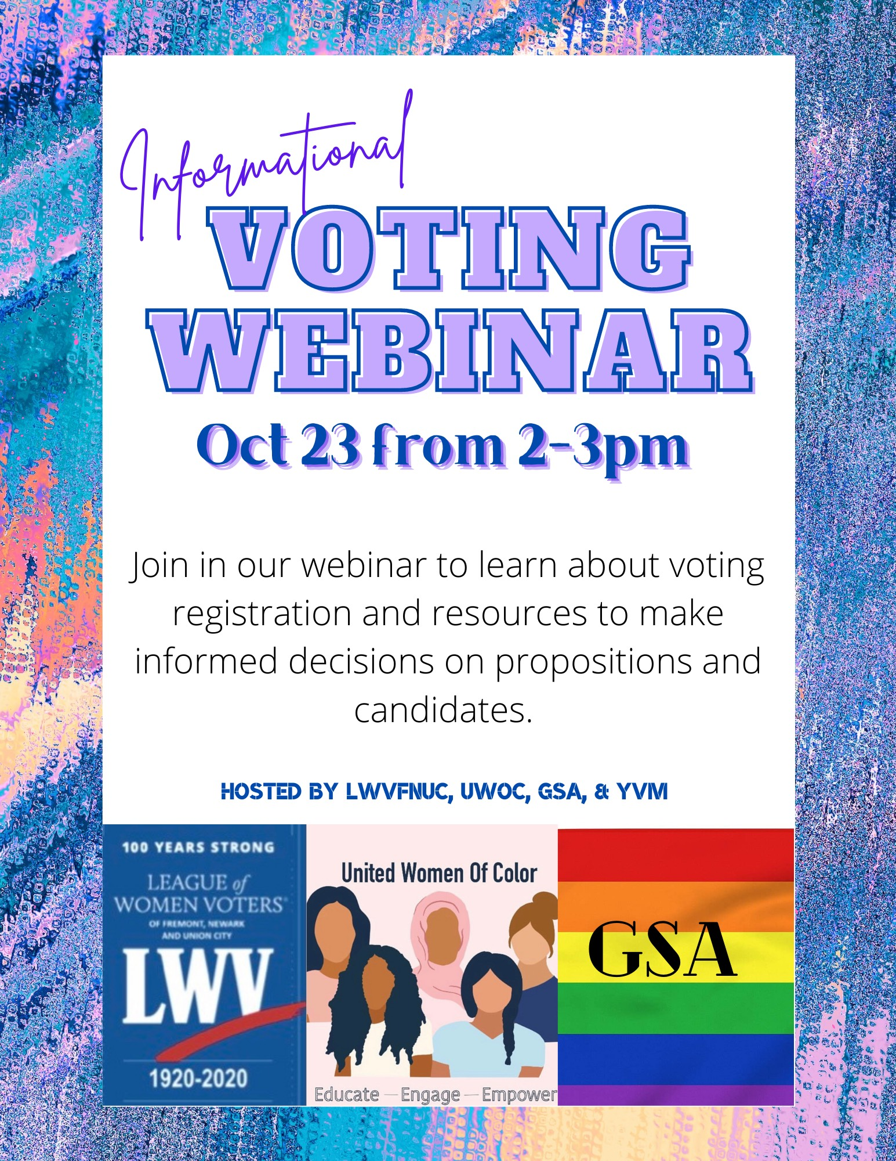
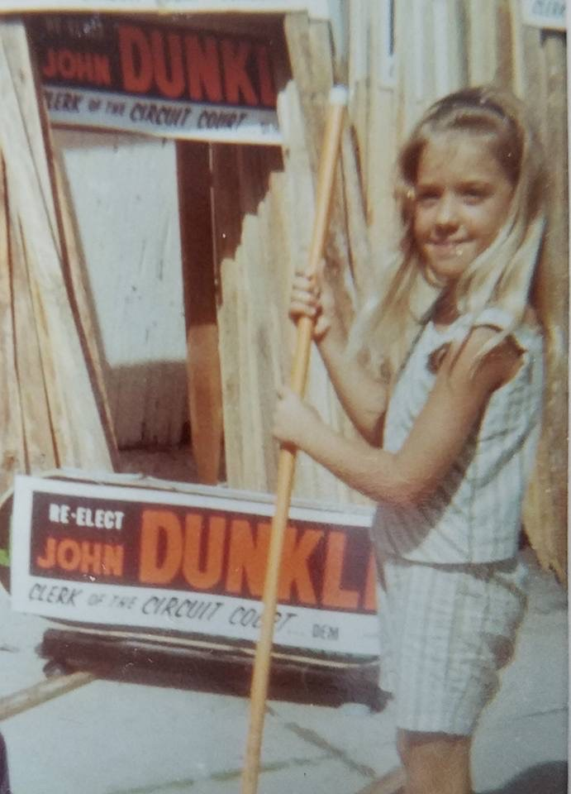
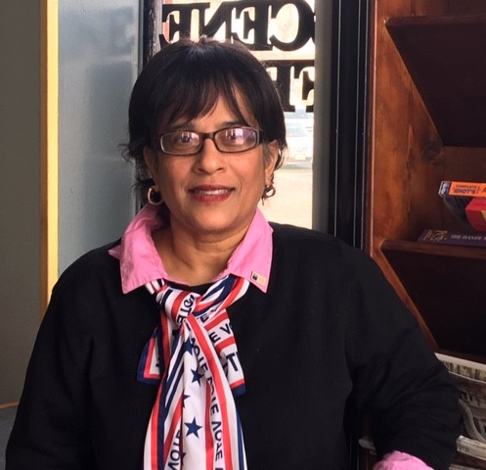
Youth Voter Movement
Voting Webinar
Ohlone - United Women of Color and Genders and Sexualities Alliance
League of Women Voters (Fremont, Newark, Union City)
Julie Dunkle and Syeda Inamdar

Slide 2
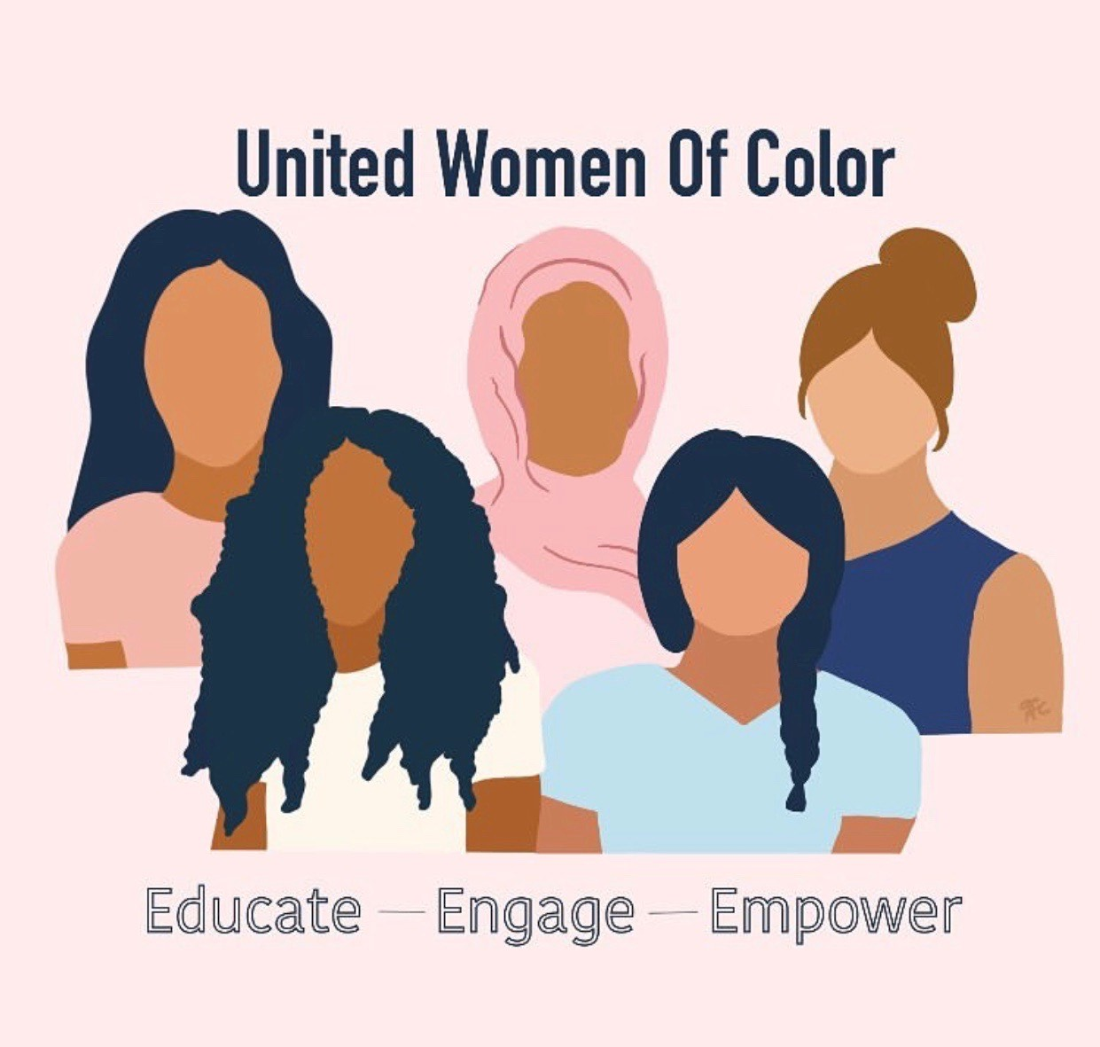
Who Are We?
Voter Education and Advocacy
100 Years Strong
Millions Registered
Includes Men and Women
Non-partisan, yet political
Registrations ~ 6,000
Youth Volunteers ~ 125
Adult Volunteers ~ 230
Ohlone College:
United Women
of Color
Ohlone College:
Genders and Sexualities Alliance

Slide 3
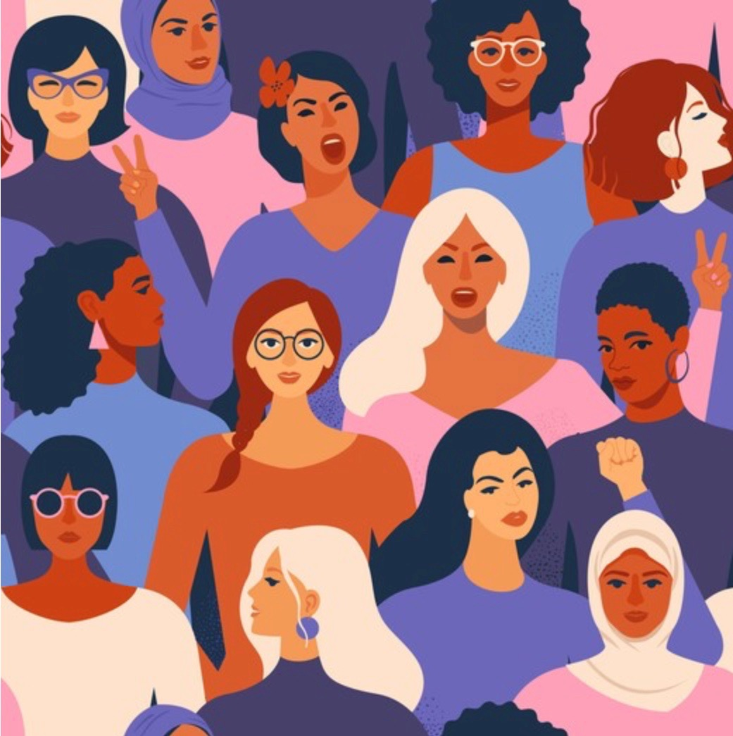
Webinar Agenda
Exploring How:
Voting Rights were/are Secured
Voting Rights were/are Suppressed
Register to Vote
Identify Important Issues
Make Informed Decisions on Candidates and Propositions
Cast Your Ballot

Slide 4
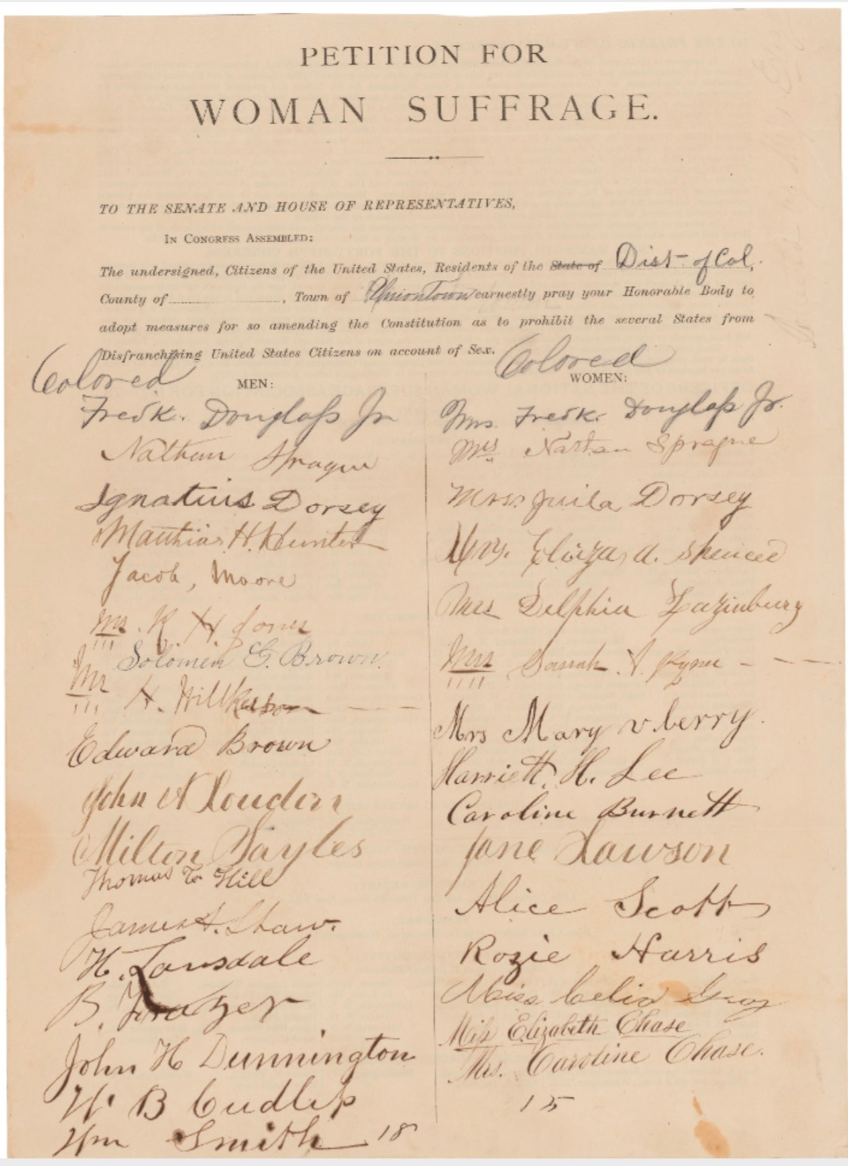
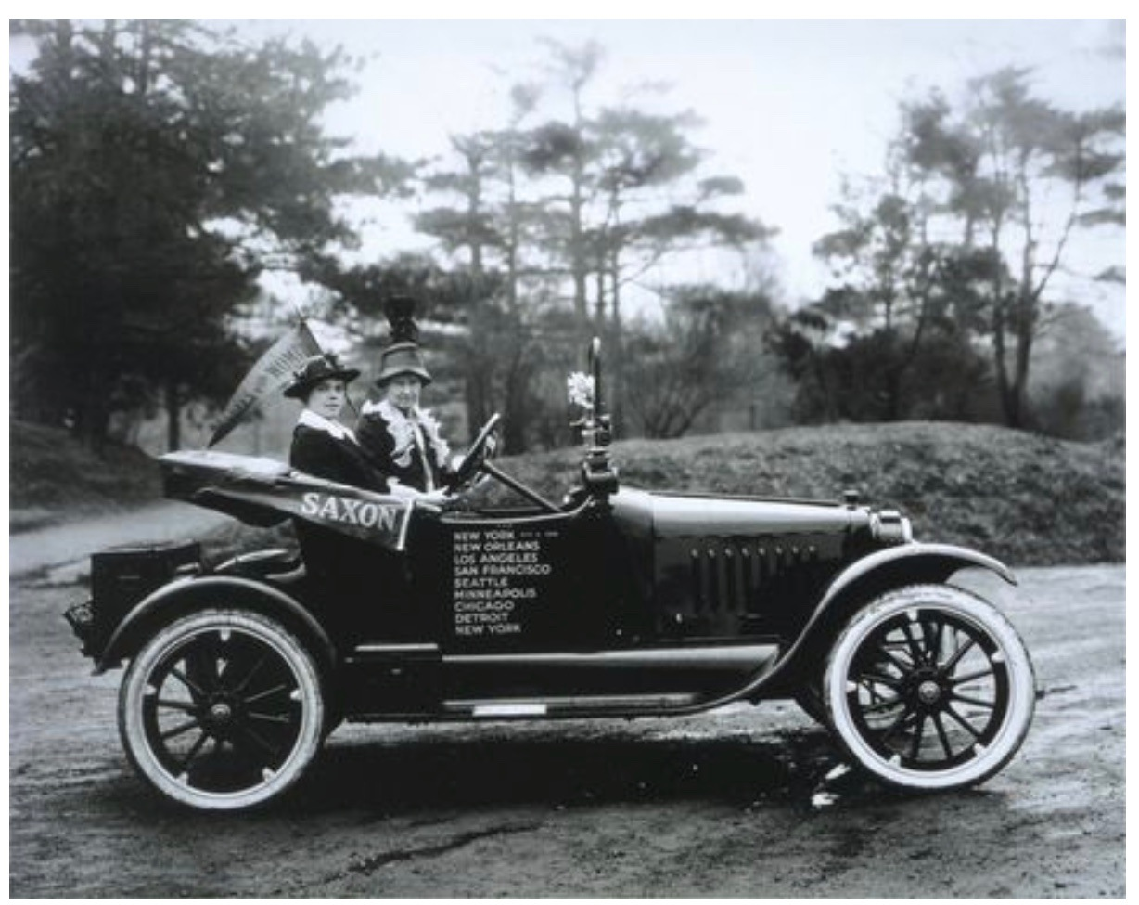
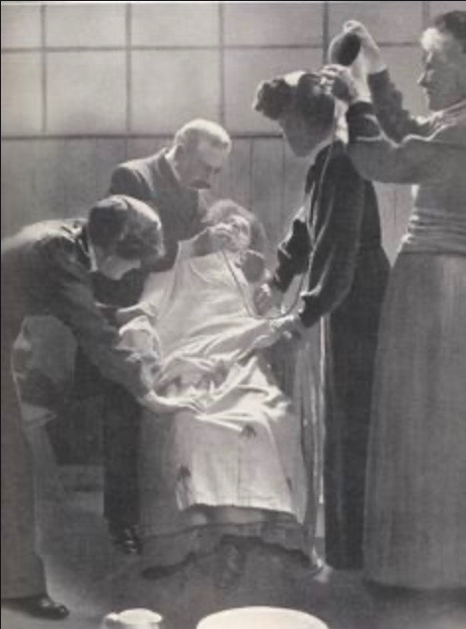
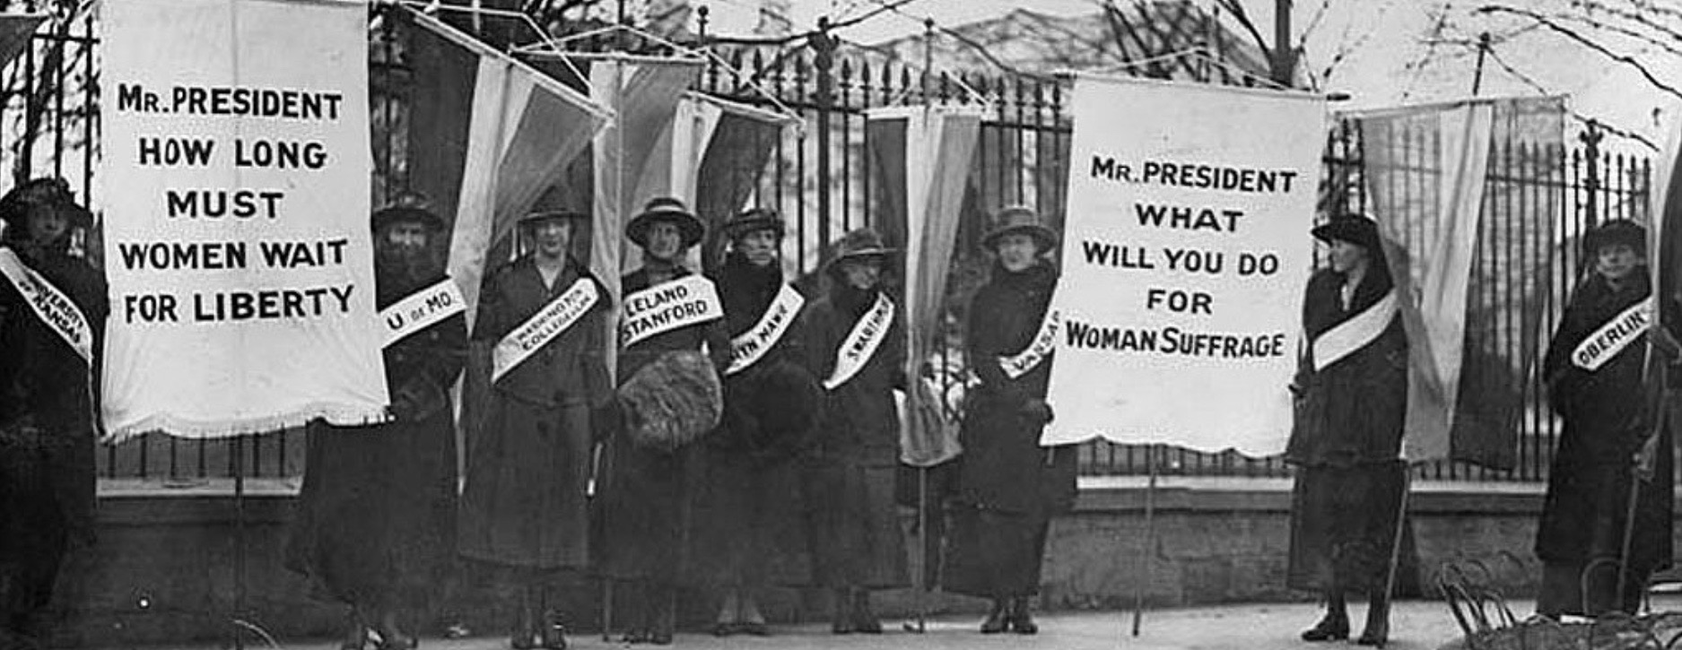
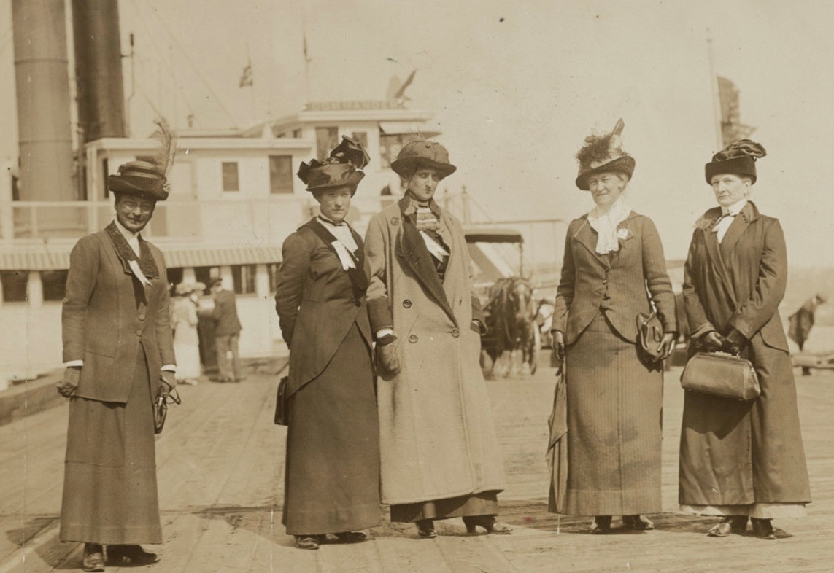
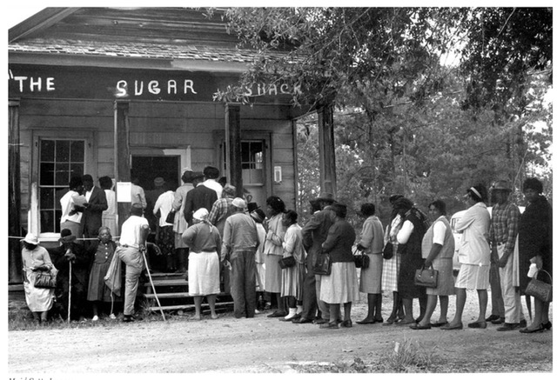
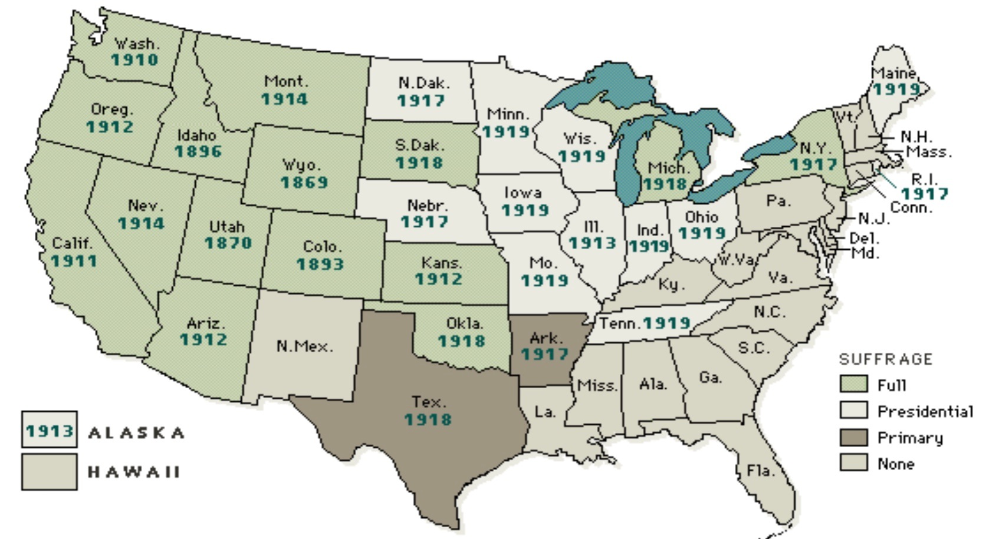
Suffrage History
US Constitution (man, white, 21+, land..)
15th Amendment, 1870, black men
19th Amendment, 1920, women
Snyder Act, 1924, native Americans
24th Amendment, 1964, no poll tax
Voting Rights Act, 1965, no racial discrimination (black women, hispanics)
26th Amendment, 1971, 18 yr olds
Proposed 1878
1/2 mil. petitions
White House Protests
Alice
Paul
Anti-Suffragists
Tennessee Last State
Black Women 1960’s

Slide 5
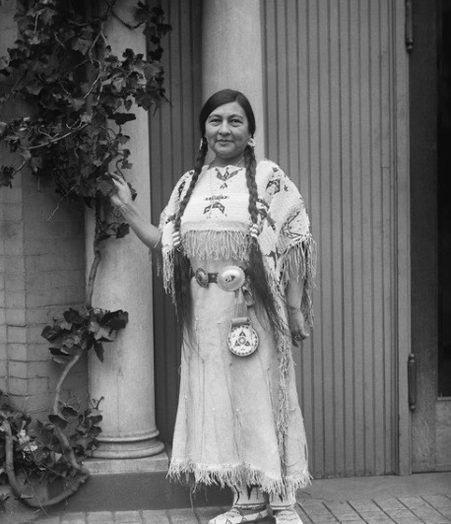
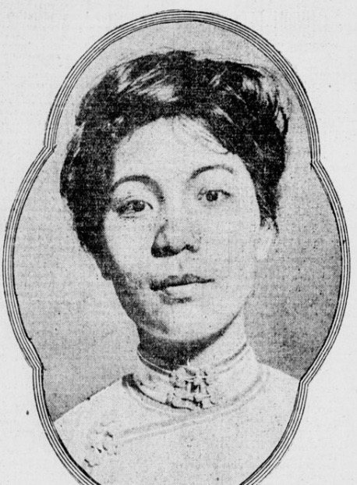
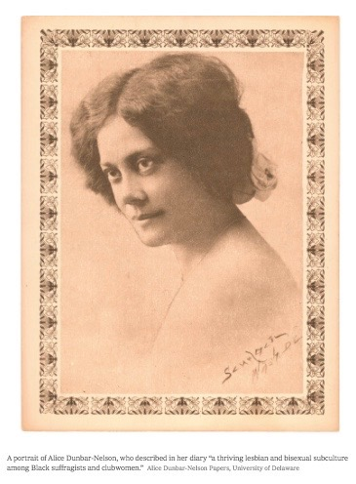
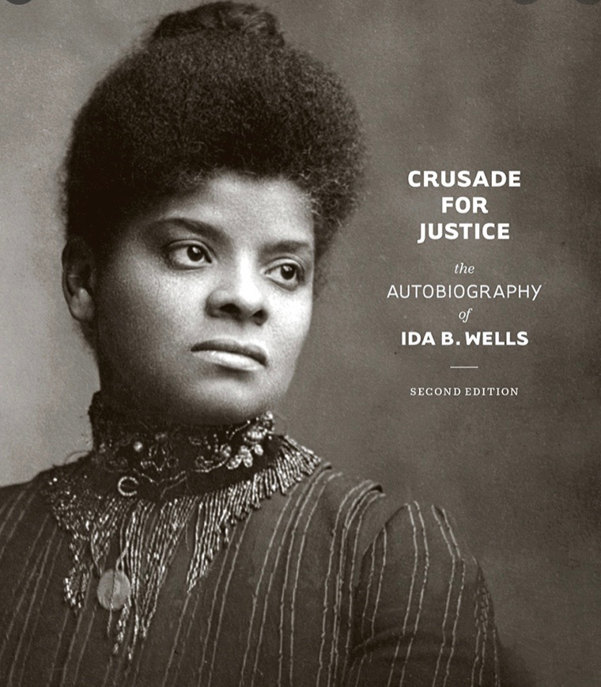
Hidden History
Gertrude Simmons
Bonnin (Zitkala-Sa)
Sioux suffragist
Women’s Rights and Suffrage
White women - won right to vote, in part by promoting white supremacy
Black women - wanted suffrage for citizenship and economic rights
Tribal women - suffrage within tribes until tribal nations became “wards of the state”; wanted suffrage for citizenship, rights to land
Asian women - 1875 Page Act: Federal law prohibited immigration of immoral (Chinese) women; wanted suffrage for citizenship, ending discrimination
LGBTQ women - many decided not to marry, led suffrage movement as single women; led the fight for suffrage as they would have no man to vote for them, needed individual women’s rights
Mabel Ping-Hua Lee
teenage suffragist
Ida B. Wells
March 1913, NAACP

Slide 6
Voter Suppression Today
Shelby Co. vs. Holder, 2013 - in 5-4 Supreme Court vote, the Voting Rights Act of 1965 was gutted by enabling voter ID requirements, polling place closures and voter roll purging no longer requires federal review (for discrimination), proofs of citizenship requirements
Poll Taxes - in Florida, 1 in 5 AA’s have felony convictions and couldn't vote until 2018; then in Sept. 2020, courts upheld new FL law requiring felons to pay all fines, fees, restitutions and costs. (Completing Sentence)
Limiting Polling Places - Since 2013, GA removed 331 polling locations; nine counties have ~50% populations and 38% of polling places, average # per polling places was 3,600 (max 2,000); in 2018, polling places w/90%> non-whites had ~51 min wait time and places w/90%> whites had ~6 min; Louisville, KY - 600,000 people to ONE polling place; tribes in NV and UT must drive 104 and 163 miles to vote, respectively. (Saving money)
Closing College Campus Polling - Polling places on college campuses are popular for students but they have been removed off-campus (TX) where ample parking isn't available for off-campus voters (Accessibility)
Gerrymandering - in 2019, Supreme Court ruled partisan gerrymandering is legal resulting in ~ 16 seats of the House of Reps changing to one party. (Fair for both parties)
Voter Roll Purging - Since Shelby, the 2016-2018 median purge rate increased by 40% in jurisdictions protected by Section 5 of the Voting Rights Act; (use it or lose it legal)

Slide 7
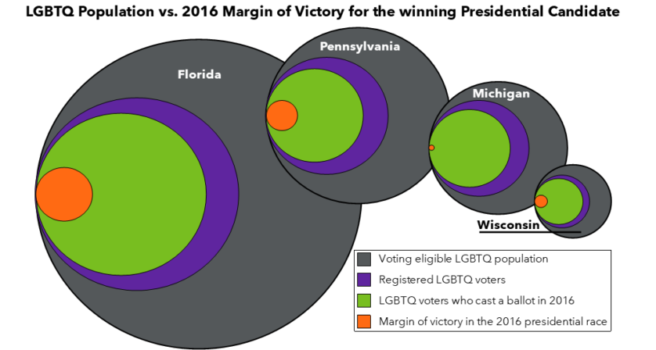
Voter Suppression Today
Voter ID Requirements - Impact low-income, young adults, people w/disabilities, people of color and LGBTQ people the most. States w/strictest laws are GA, AL, MS, TN, VA, IN, WI and KS and 15 states have no voter ID laws; In 2020. (Combat voter fraud)
965,350 transgender adults are eligible to vote
378,450 of those do not have ID’s that reflect their correct name and/or gender
81,000 eligible transgender adult voter reside in above 8 states w/strictest laws
Challenges
Photo ID Requirements - match gender identity, for transgenders super difficult, during Covid, DMVs limited
Voter Registration - usually require binary gender choices (CA eliminated gender)
Name Changes - strict exact match laws disenfranchise LGBTQ
Source:
https://www.thetaskforce.org/queerthevote.html

Slide 8
Why Voting is Important
Source: Marie Claire Magazine
https://www.marieclaire.com/politics/a33264457/women-voting-2020-election/

Slide 9
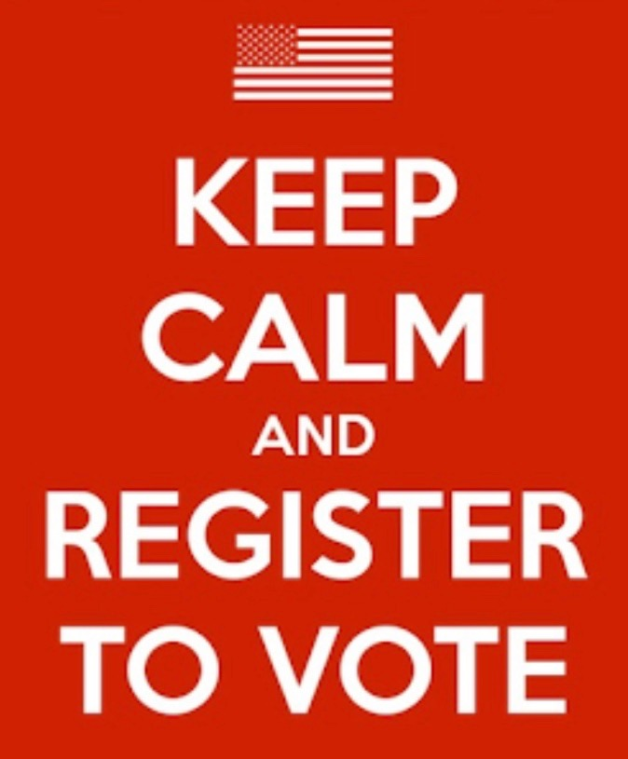
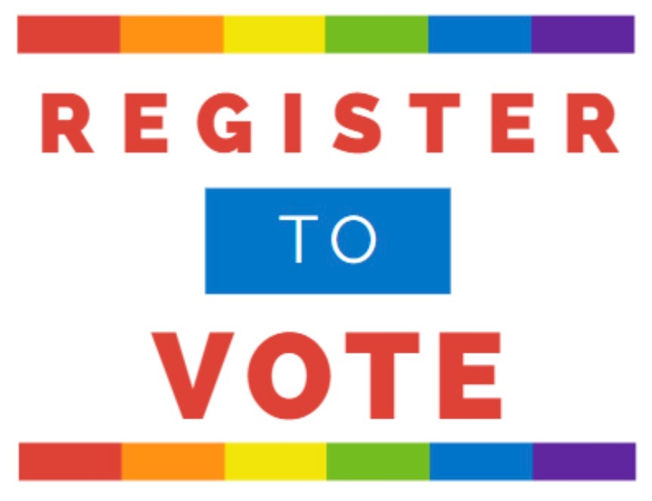
Registering to Vote
www.youthvotermovement.org/register
Register at Polls: Oct 31 - Nov 3
Bring CA DMV ID, school ID, or passport
Vote Provisionally - after registration is confirmed, ballot vote is counted
Check Your Registration and Make Changes - www.acvote.org

Slide 10
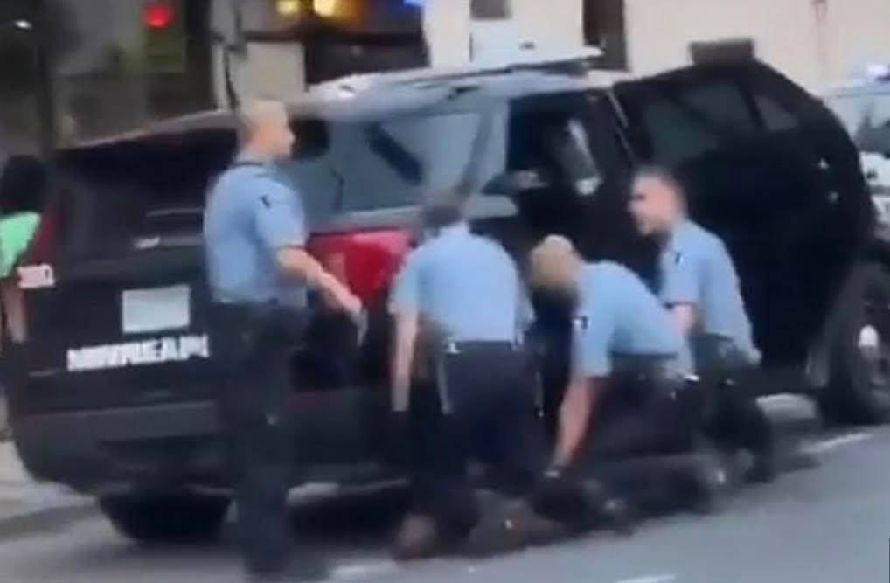
Identify Important Issues
Women/POC
LGBTQ
Social Justice
Immigration Detention - risk of harm
Healthcare - nondiscrimination and access
Housing No Fed and 54% states can legally discriminate, results homelessness
Faith-based Discrimination
Criminal Justice - 40% of incarcerated youth and women are LGBTQ (de-criminalize drug use, sex work, homelessness)
Reproductive Rights - access to abortions, contraceptives
Equal Pay for Equal Work
Education - Affirmative Action P16, help close wealth gap; tracking to juvenile system; increased funding P15
Defund/Upfund Police
Adopt Breonna Law
Suffrage for Parolees P17
Incarceration P20
Bail Alternatives P25
Source
Queer the Vote Voter Guide
Source
Women’s Foundation of CA
Source
BLM - 8 Can’t Wait

Slide 11
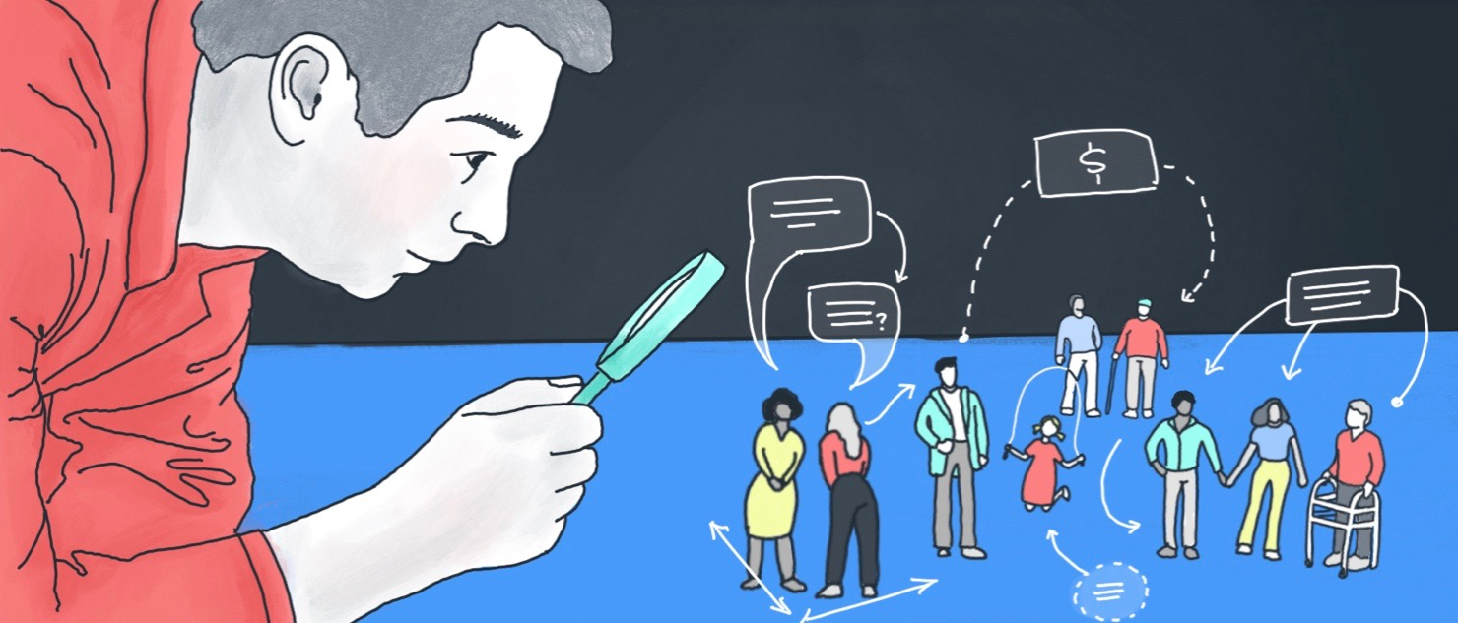
Make Informed Decisions
Do your Research
Compare and Contrast
Follow the Money
Review Endorsements (Newspapers)
Talk to Family/Friends
Don’t have to vote on everything

Slide 12
Resources
Voters Edge - www.votersedge.org
Voter Information Booklets
CA Secretary of State - https://voterguide.sos.ca.gov/
LWV FNUC EVG - https://lwvc.org/sites/default/files/downloads/EVG-Nov2020-Eng.pdf
Candidate Forums - https://my.lwv.org/california/fremont-newark-union-city/2020-candidate-forums
Proposition Forums - https://my.lwv.org/california/fremont-newark-union-city/ballot-propositions-2020-november-election
CA LWV Prop Recommendations - https://lwvc.org/news/VOTEwiththeLeague
Legislative Analyst Office (Props) - https://lao.ca.gov/BallotAnalysis/Propositions
CAL Matters - https://calmatters.org/election-2020-guide/
Harvey Milk Club - http://www.milkclub.org/endorsements
AAUW Gender Policy - https://www.aauw.org/resources/policy/aauws-2020-gender-policy-agenda/

Slide 13
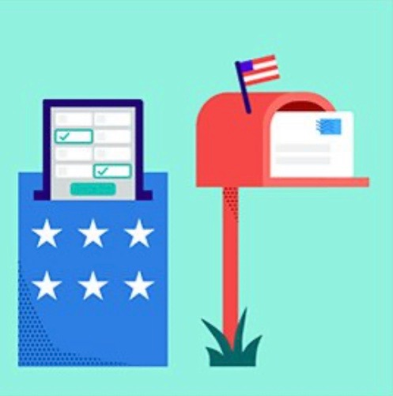
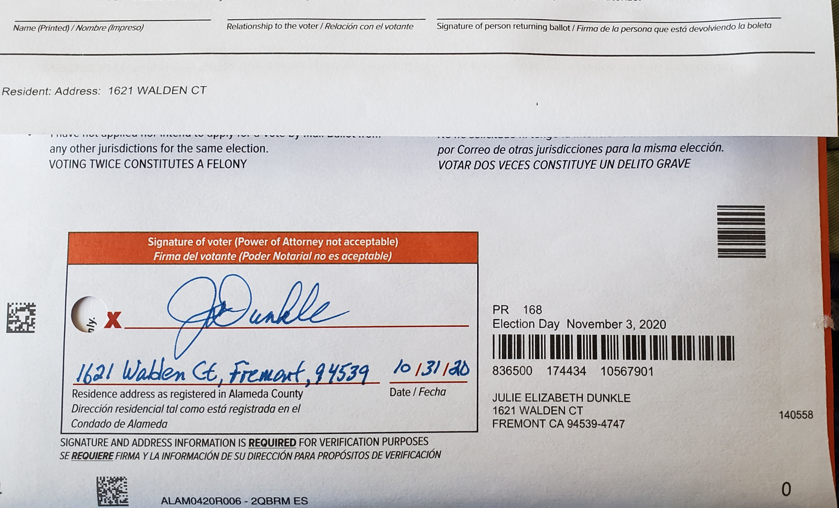
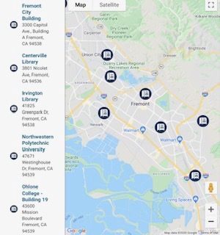
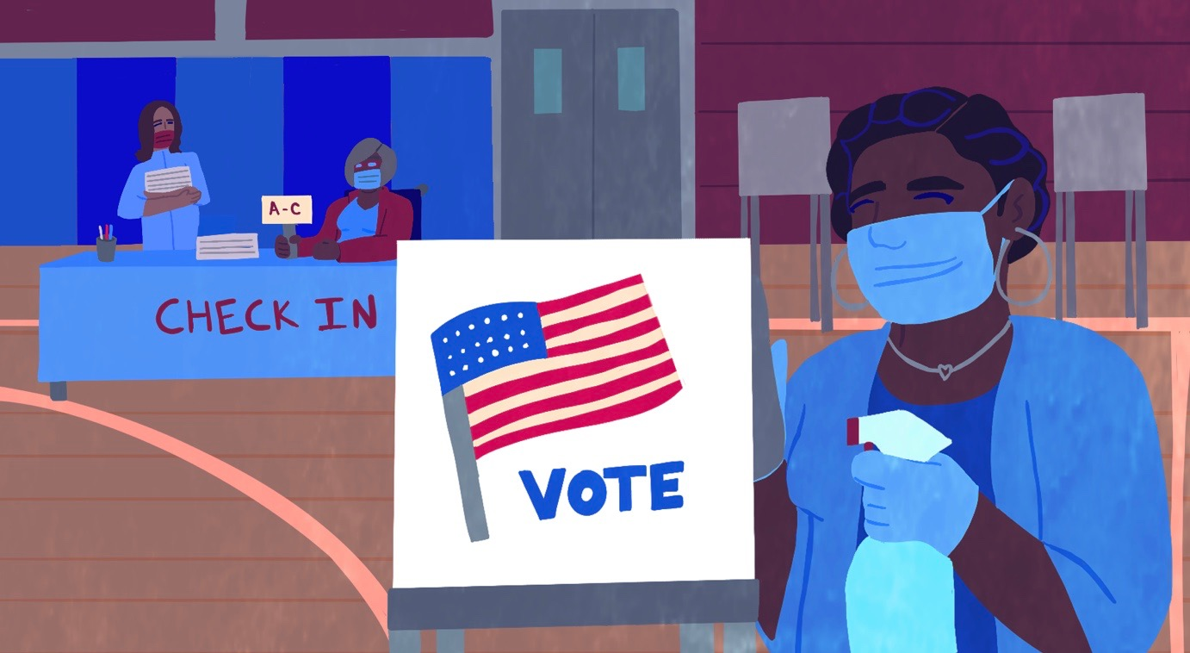
Cast Your Ballot
Register - www.youthvotermovement.org/register
Track Ballot - california.ballottrax.net
Vote by Mail - no postage, must be postmarked by 11/3
Vote by Ballot Drop Box (4 in Fremont)
Vote at Polling Places (12) 10/31 through 11/03
Bring CA DMV ID, Student ID, Passport (may not be needed)
Find Location/Times: www.acgov.org/rovapps/maps/avl/
Use blue/black ink, seal envelope, SIGN and state address/date

Slide 14
Get Involved
LWV Fremont, Newark, Union City - https://my.lwv.org/california/fremont-newark-union-city/join
***Free student memberships***
Youth Voter Movement - www.youthvotermovement.org
OC: United Women of Color Club - https://uwocohlone.weebly.com
OC: Genders and Sexualities Alliance - ohlonegsa@gmail.com
Super Majority (women’s advocacy) - https://supermajority.com/
Queer the Vote Info Guide - www.thetaskforceactionfund.org
What Will It Take (resources) - www.whatwillittake.com
American Association of University Women (scholarships) - www.aauw.org

Slide 15
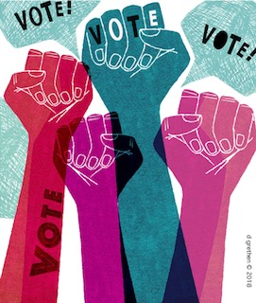
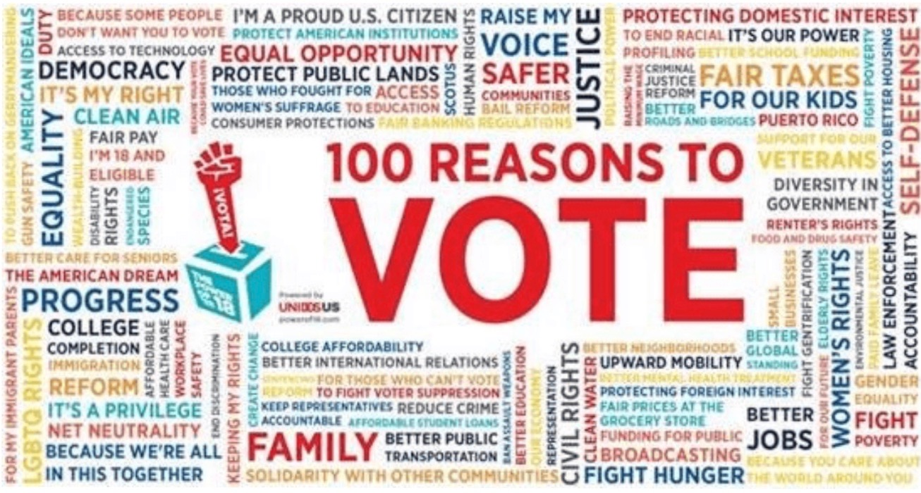
Questions / Comments
Thank You - Your Vote Matters

